Slide 1



202118010402 Qinglian Li (Jane)
YOLOv5s-Fire
—— Forest Fire Detection and Severity Assessment Using Improved YOLOv5 on Satellite Imagery
Oxford Brookes University in collaboration with Chengdu University of Technology, BSc Computer Science Supervised by Dr. Irfan Ullah
Notes:
各位老师好，我叫李青莲，我的导师是Dr. Irfan Ullah，我的论文主题是Forest Fire Detection and Severity Assessment Using Improved YOLOv5 on Satellite Imagery.
The paper proposed an advanced object detection framework named YOLOv5s-Fire based on the lightweight YOLOv5s architecture which is specifically designed for the detection of wildfire locations in satellite imagery, which provides a lightweight and efficient solution suitable for deployment in resource constrained wildfire monitoring systems, which is expected to achieve earlier fire detection and early warning.
本文在轻量级YOLOv5s架构的基础上，针对卫星图像中野火位置的检测，提出了一种先进的目标检测框架YOLOv5s- fire，提供了一种轻量级、高效的解决方案，适用于资源受限的野火监测系统，有望实现更早的火灾探测和预警。

Slide 2

1
Backgroud Review
2
Improvement Process
Content
3
Experiment Result
4
Conclusion
Notes:
接下来我将从Backgroud Review, Improvement Process, Experiment Result, Conclusion这四个方面阐述我的论文。

Slide 3


Backgroud Review
Improvement Process
Experiment Result
Conclusion
Research Background
The average area burned by each wildfire is up to 20 hectares and the global average annual area burned is more than 25,000 hectares.[1]
Traditional Detection
Slow monitoring response
Difficult analysis of satellite image
YOLO Algorithm
Limited coverage
Target detection -> Real time + Precision
Notes:
Forests as a crucial component for maintaining the ecological balance of the Earth，encompass abundant natural resources and offer the environment requisite for human survival. As indicated by statistics from the Global Wildfire Information System, the average burned area of each wildfire amounts to as high as 20 hectares, and over 25,000 hectares of forest are devastated by wildfires annually. Hence, detecting the location and severity of forest fires rapidly and precisely is an essential measure to alleviate their detrimental effects.
Although the traditional monitoring methods, such as ground sensors and drone patrols have reduced the incidence of forest fires to some extent, they are still limited by factors such as response speed and coverage.
Meanwhile, to the relatively low spatial resolution of imagery and the diverse manifestations of areas affected by fires, it is challenging to directly determine the exact location and severity of fires based on satellite imagery data alone.
The application of deep learning techniques, in particular YOLO algorithm, has yielded significant outcomes in the domains of image classification and target detection, which has brought new opportunities for remote sensing fire detection.
森林是维持地球生态平衡的一个重要组成部分，拥有丰富的自然资源，并提供人类生存所必需的环境。根据全球野火信息系统（Global Wildfire Information System）的统计，平均每场野火的烧毁面积高达20公顷，每年有超过2.5万公顷的森林被野火摧毁。因此，迅速准确地探测森林火灾的位置和严重程度是减轻其有害影响的必要措施。
虽然地面传感器、无人机巡逻等传统监测方法在一定程度上降低了森林火灾的发生率，但仍受到响应速度和覆盖范围等因素的限制。
同时，由于影像空间分辨率较低，火灾影响区域表现多样，仅凭卫星影像数据直接确定火灾的准确位置和严重程度具有一定的挑战性。
深度学习技术特别是YOLO算法在图像分类和目标检测领域的应用取得了显著成果，为遥感火灾检测带来了新的机遇。

Slide 4


Backgroud Review
Improvement Process
Experiment Result
Conclusion
Comparison of Different Research
Research | Model | DataSet | Performance Index
Khan et al.[2] | VGG19 | DeepFire | Accuracy = 98.89% Precision = 95.72%
Seydi et al.[3] | YOLOv5 + U-Net (Fire-Net) | Landsat-8 | Overall Accuracy = 97.35% Precision = 93.49%
Yuan et al.[4] | YOLOv5 + Transformer | FLAME, self-built fire dataset | Accuracy = 93.25% Precision = 92.85%
Xu et al.[5] | YOLOv5 + EfficientNet | BowFire, FD-dataset, ForestryImages, VisiFire | Accuracy = 99.6% Average Precision = 85.5%
Kang et al.[6] | CNN + RF | Himawari-8 AHI | Overall Accuracy = 98% Precision = 91%
Ding et al.[7] | Mask R-CNN (FSF-Net) | MODIS_Smoke_FPT dataset | Accuracy = 89.12%
Notes:
From the table, we can see:
VGG19 is suitable for the requirements of high-precision image classification, but it is insufficient to complete the object detection task alone, and at the same time, the computing cost is high.
Xu et al. combine the YOLOv5 andEfficientNet model, which can enhance the generalization ability, but the performance indicators need to be balanced. Although the multi-source datasets used enhance robustness, the issue of annotation consistency needs to be addressed.
The satellite meteorological data of Landsat-8 and Himawari-8 are suitable for large-scale monitoring, but the resolution is limited.
从表中我们可以看到：
VGG19适合高精度图像分类需求，不足以单独完成目标检测任务，同时计算成本高。
Xu et al. combine the YOLOv5 andEfficientNet model, 可提升泛化能力，但需平衡性能指标。 虽然使用的多源数据集增强了鲁棒性，但需解决标注一致性问题。
Landsat-8和Himawari-8的卫星气象数据适合大范围监测，但分辨率受限。

Slide 5
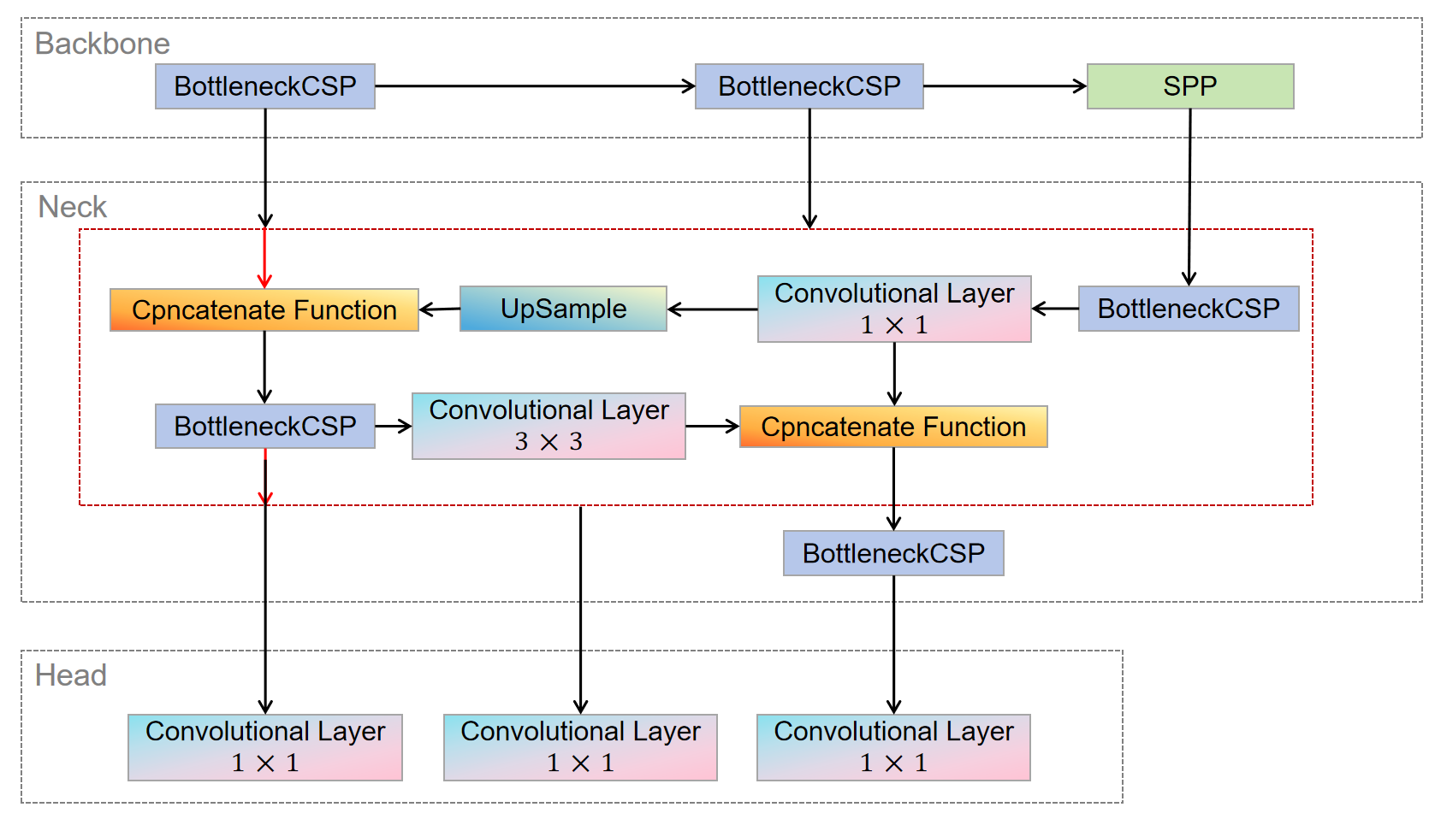
Backgroud Review
Improvement Process
Experiment Result
Conclusion
YOLOv5 Structure
Focus + BottleneckCSP×4 + SSP
FPN +PAN
+
Concatenate + UpSample
Detection Layer
Notes:
Let's understand the architecture of YOLOv5...
1. Backbone
Focus: Expands input channels via slicing and downsampling, reducing computational costs while preserving spatial details.
BottleneckCSP×4: Cross-stage residual structure for enhanced feature reuse
SPP: Enables multi-scale feature fusion, improving robustness to variations in wildfire sizes.
2. Neck
FPN+PAN: Bidirectional feature pyramid, fusing deep and shallow features.
Concatenate: Cross-layer feature concatenation
UpSample: Upsample the recovery resolution.
3. Head
Detection Layers: 1×1 convolution ×3, output classification and positioning results.

Slide 6
Backgroud Review
Improvement Process
Experiment Result
Conclusion
YOLOv5 (You Only Look Once version 5)
Single-stage Detection Framework
Efficient Network Architecture Design
Dynamic Anchor Box
End-to-End Training and Inference
Real-time Detection
Low Computational Cost
Adaptively Optimize
Precise Localization
Notes:
1. Single-stage Detection Framework: YOLOv5 adopts a single-stage detection mechanism, performing object localization and classification in a single forward pass, which eliminates the need for region proposal generation, significantly improving inference speed. It's a critical feature for real-time fire monitoring scenarios.
2. Efficient Network Architecture Design: It effectively reduces the computational complexity while maintaining high accuracy.
3. Dynamic Anchor Box Optimization：YOLOv5 automatically optimizes anchor box dimensions during training, adjusting prior box ratios based on dataset characteristics. Compared to models with fixed anchors YOLOv3, this allows better adaptation to the shapes and distributions of wildfire targets in satellite imagery.
4. End-to-End Training and Inference: YOLOv5 provides a comprehensive end-to-end optimization pipeline, from Mosaic augmentation to CIoU Loss. The CIoU Loss incorporates not only overlap area but also penalties for center distance and aspect ratio, improving bounding box regression accuracy.
1. 单阶段检测框架：YOLOv5采用单阶段检测机制，在单次前向遍历中完成目标定位和分类，无需生成区域建议框，显著提高了推理速度。它是实时火灾监控场景的关键特性。
2. 高效的网络架构设计：在保持高精度的同时有效降低了计算复杂度。
3. 动态锚框优化：YOLOv5在训练过程中自动优化锚框尺寸，根据数据集特征调整先验框比例。与锚点固定的YOLOv3模型相比，可以更好地适应卫星图像中野火目标的形状和分布。
4. 端到端训练和推理：YOLOv5提供了一个全面的端到端优化管道，从马赛克增强到CIoU损失。CIoU损失不仅包含重叠区域，还包含对中心距离和长宽比的惩罚，提高了边界框回归精度。

Slide 7
Backgroud Review
Improvement Process
Experiment Result
Conclusion
—— Why choose YOLOv5?
—— To better handle the task of forest wildfire detection.
Conclusion：YOLOv5 Model The model is highly suitable for forest wildfire detection in satellite images
YOLOv5’s lightweight architecture, multi-scale detection capability and modular design make it an ideal choice for fire detection in satellite images.
YOLOv5s Model
Lightest version of YOLOv5
Reduce computational complexity
Maintain detection accuracy
Multi-scale Feature Fusion
Highly Modular Architecture
Strong Initial Feature Extraction Capability
Notes:
1. Multi-scale Feature Fusionn： By integrating FPN (Feature Pyramid Network) and PAN (Path Aggregation Network), YOLOv5 achieves multi-scale feature fusion. This enables effective detection of wildfires at varying scales in satellite imagery (e.g., small initial fires, spreading mid-sized fires, and large canopy fires), which is essential for dynamic forest fire monitoring.
2.Highly Modular Architecture：YOLOv5’s architecture (Backbone, Neck, Head) is highly modular, allowing flexible replacement or enhancement of specific components. For instance, in this project, the integration of GhostConv to reduce parameters, CBAM attention mechanisms to improve feature focus, and the SPPFire module for optimized multi-scale pooling all leverage its modular design.
2.Strong Initial Feature Extraction Capability: YOLOv5’s pre-trained weights on large-scale datasets like COCO provide robust initial feature extraction capabilities. Transfer learning enables rapid adaptation to satellite-based wildfire detection tasks, reducing training time and data requirements.
YOLOv5s, the most lightweight variant of the YOLOv5 series, maintains high detection accuracy while significantly reducing computational complexity. This is particularly critical for satellite image processing tasks, which involve large data volumes and require near-real-time analysis. Its lightweight nature also makes it suitable for deployment on resource-constrained edge devices, such as drones or low-power monitoring stations.
1. 多尺度特征融合: YOLOv5通过结合FPN（特征金字塔网络）和PAN（路径聚合网络），实现了多尺度特征融合，能够有效捕捉卫星图像中不同规模的火灾特征（如初期小火、蔓延中的中火和大型林冠火）。这一特性对森林火灾动态监测至关重要。
2. 高度模块化特性: YOLOv5的架构（Backbone、Neck、Head）具有高度模块化特性，允许灵活替换或增强特定组件。例如，在本项目中，通过引入GhostConv降低参数量、集成CBAM注意力机制增强特征聚焦能力，以及设计SPPFire模块优化多尺度池化，均得益于其模块化设计。
3. 强大的特征提取能力：YOLOv5在COCO等大型通用数据集上的预训练权重为模型提供了强大的初始特征提取能力，通过迁移学习可快速适配卫星图像的火灾检测任务，减少训练时间和数据需求。
YOLOv5s作为YOLOv5系列中最轻量的版本，在保持较高检测精度的同时显著降低了计算复杂度。这对于卫星图像处理任务尤为重要，因为卫星数据量大且需要实时或近实时处理。此外，其轻量化特性使其更适合部署在资源受限的边缘设备（如无人机或低功耗监测站）中。

Slide 8
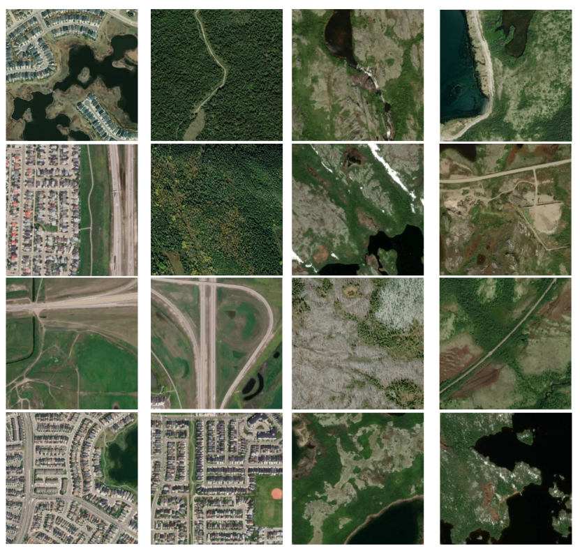
Backgroud Review
Improvement Process
Experiment Result
Conclusion
1. Dataset Preprocessing
Images of wildfire and no-wildfire classes
Source of the Dataset
Wildfire Prediction Dataset
(Satellite Images) from Kaggle
DataSet Selection
Original Dataset Distribution
DataSet | Training | Testing | Validation | Total
wildfire | 15898 | 3406 | 3406 | 22710
No-wildfire | 14098 | 3021 | 3021 | 20140
Total | 400 | 6427 | 6427 | 42850
Notes:
This proposed project intends to use the Wildfire Prediction Dataset (Satellite Images) from Kaggle for the object detection problem of wildfire images. The dataset is derived from satellite images of areas that have previously experienced wildfires in Canada and is divided into two classes: fire and no-fire. The fire class contains forest and mountain regions or images with invisible black flames or gray smoke clouds. In contrast, the no-fire class contains images of forests and cities from different angles. The random samples of images both classes in the Wildfire dataset are shown in Figure.
There are a total of 42,850 images in the Wildfire dataset, of which 22,710 are fire examples and the remaining 20,140 belong to the no-fire class, as shown in Table 2. All images have an initial resolution of 350 × 350 pixels.

Slide 9
Backgroud Review
Improvement Process
Experiment Result
Conclusion
1. Dataset Preprocessing
Data Screening Criteria
Data screening
DataSet | wildfire | No-wildfire | Total
Number | 200 | 200 | 400
(1) Image Clarity
(2) Label Reliability
(3) Scene Coverage
DataSet
Screening
Image Resize
350 × 350
Notes:
Based on the original Wildfire data set, this project constructs a high-quality sample set through manual screening. Screening criteria included:
(1) Image clarity: exclude blurred or low-resolution samples.
(2) Label reliability: wildfire images should clearly contain fire or smoke features and no-wildfire images should have no relevant traces.
(3) Scene coverage: it covers diverse backgrounds such as forests, mountains and cities.
After filtering, a total of 400 images were selected, consisting of 200 wildfire samples and 200 non-wildfire samples. The dataset was deliberately balanced in terms of class distribution to mitigate training bias and facilitate more stable convergence during optimization. The balanced composition ensures that the model can effectively learn to distinguish between wildfire and no-wildfire scenes, promoting fair and reliable evaluation across all sample types.

Slide 10
Backgroud Review
Improvement Process
Experiment Result
Conclusion
1. Dataset Preprocessing
Dataset Segmentation
Stratified Sampling
A separate test set of 50 images
300 training images and 100 validation images
DataSet Splitting
75% : 25%
DataSet | Training | Testing | Total
wildfire | 150 | 50 | 200
No-wildfire | 150 | 50 | 200
Total | 300 | 100 | 400
Notes:
The filtered dataset was subsequently partitioned into a training set and a validation set using a randomized 75%:25% split ratio, yielding 300 training images and 100 validation images, as shown in Table 3. The splitting process was performed with stratified sampling to ensure that the wildfire and no-wildfire remained consistent across subsets.
To independently evaluate the model’s generalization performance, a separate test set comprising 50 images was sampled from the unfiltered portion of the original dataset. In order to prioritize the assessment of the model’s sensitivity and accuracy in detecting fire-related events, the test set was deliberately constructed to include 40 wildfire images and 10 non-wildfire images, as detailed in Table 4. This test configuration not only reflects the critical importance of accurate wildfire detection in emergency scenarios but also serves to validate the model’s practical applicability under conditions of class imbalance and visual variability.

Slide 11
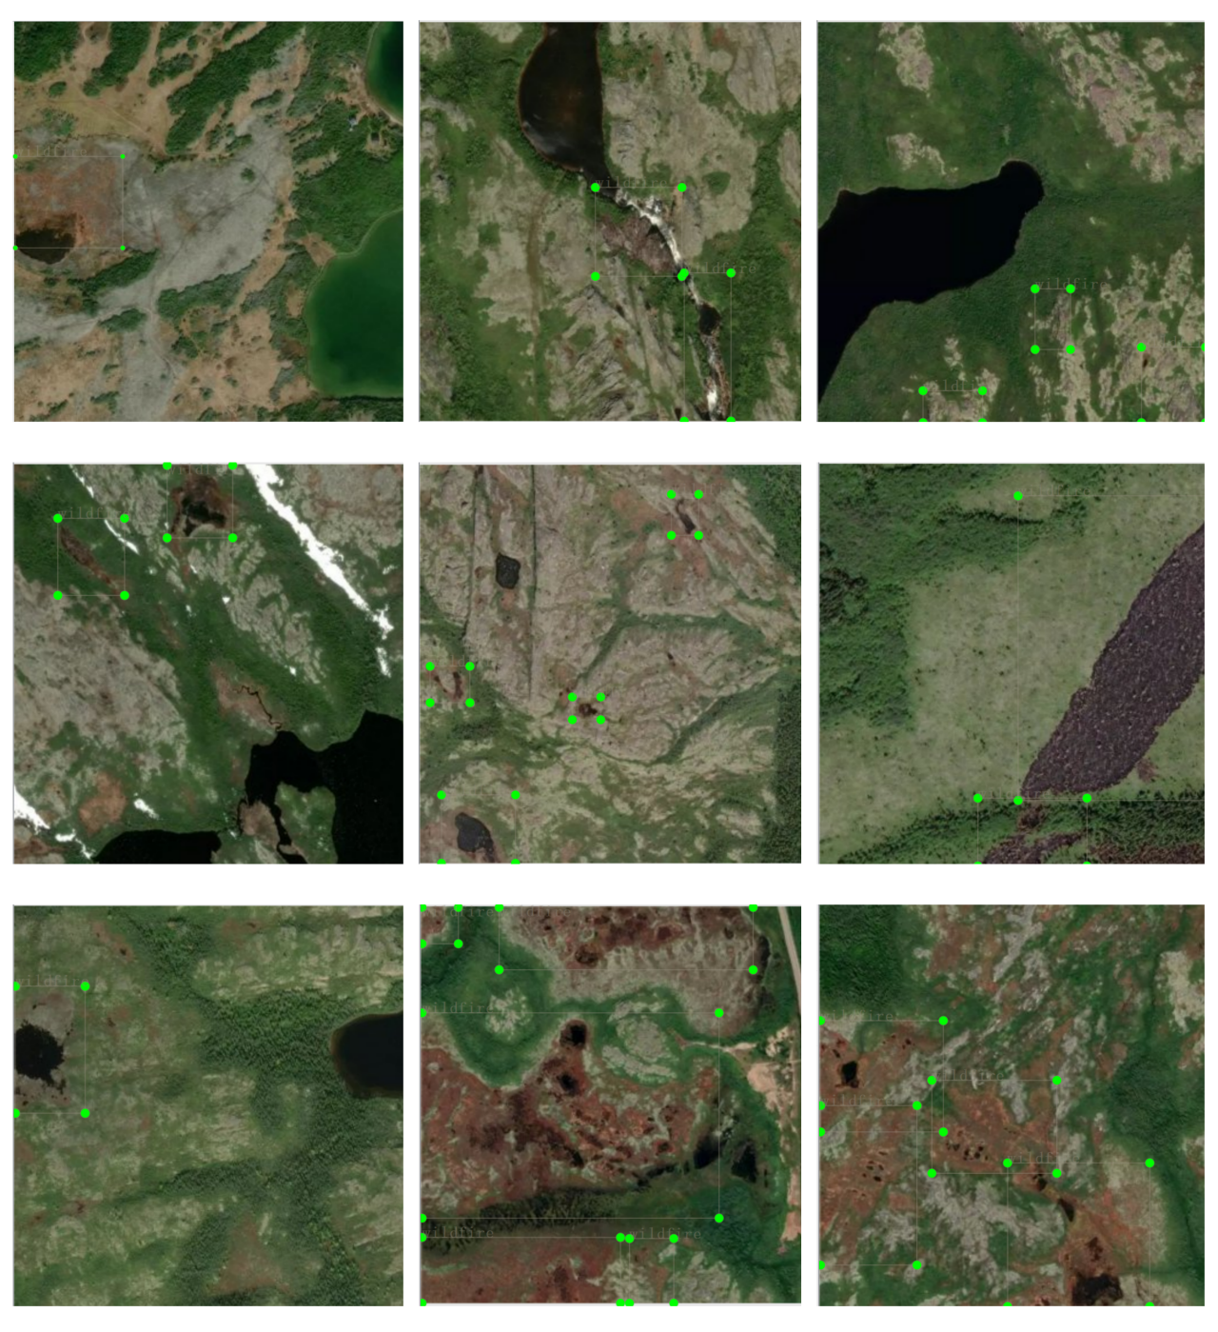
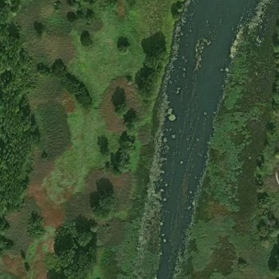
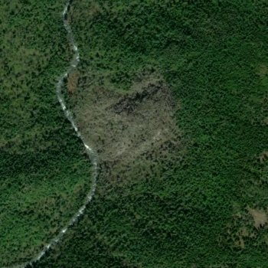
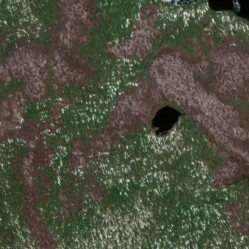
Backgroud Review
Improvement Process
Experiment Result
Conclusion
1. Dataset Preprocessing
Random samples after wildfire image labeling
Wildfire > Positive
No-wildefire > Negtive
Image Annotation
YOLO Format
LabelImg
1. Object Category
2. Normalized Bounding Box Coordinates
Notes:
To ensure high-quality input for model training and evaluation, we implemented a structured data preprocessing workflow encompassing both wildfire and non-wildfire imagery. For wildfire samples, we employed the open-source annotation tool LabelImg to manually annotate visible fire regions with bounding boxes. As shown in Figure, the annotated fire images are displayed. The annotations were saved in the YOLO format, which records object class and normalized bounding box coordinates, ensuring compatibility with real-time object detection frameworks. This format is lightweight and well-suited for real-time object detection tasks. For non-wildfire images, which inherently contain no fire regions, we generated corresponding empty label files to denote the absence of any target objects. These images serve as negative samples, enabling the model to distinguish between fire and non-fire scenes more effectively. This annotation strategy enables a clear distinction between positive and negative samples, promotes robust feature learning, and supports effective training in the presence of class imbalance, which is critical for minimizing false positives and enhancing the robustness of the detection system in diverse real-world environments.

Slide 12
Backgroud Review
Improvement Process
Experiment Result
Conclusion
2. Proposed Model -- Based YOLOv5s
GhostConv -> Replace the standard convolution with GhostConv.
C3Ghost -> Integrate GhostConv in the C3 module.
CBAM Attention -> Insert channels and spatial attention modules in the Backbone and Head.
SPPFire -> Combine the SPP with the Fire module.
Optimize the hierarchical connection of Backbone
Simplify the output logic of Head
Notes:
The standard convolution is replaced by GhostConv. By generating some feature maps and then performing linear transformation, the computational load and the number of parameters are reduced.
Integrate GhostConv in the C3 module to enhance the feature reuse capability and further improve the lightweight efficiency.
Insert channels and spatial attention modules in the Backbone and Head to enable the model to dynamically focus on important feature areas and improve the detection accuracy in complex fire backgrounds.
Combining the SPP with the Fire module can expand the receptive field while reducing the number of parameters to balance the requirements of multi-scale feature extraction and lightweight.
Optimize the hierarchical connection of the Backbone, insert CBAM after GhostConv, and enhance the feature selection ability.
Simplify the Head output logic and only pass the number of categories (nc) and anchor boxes (anchors) to the Detect layer.
使用GhostConv替换标准卷积, 通过生成部分特征图再线性变换，减少计算量和参数量.
在C3模块中集成GhostConv, 增强特征复用能力，进一步提升轻量化效率。
在Backbone和Head中插入通道与空间注意力模块, 使模型动态关注重要特征区域，提升复杂火灾背景下的检测精度。
将SPP与Fire模块结合，在扩大感受野的同时减少参数量平衡多尺度特征提取与轻量化需求。
优化Backbone的层级连接， 在GhostConv后插入CBAM，强化特征选择能力。
简化Head输出逻辑，仅向Detect层传递类别数（nc）和锚框（anchors）。

Slide 13
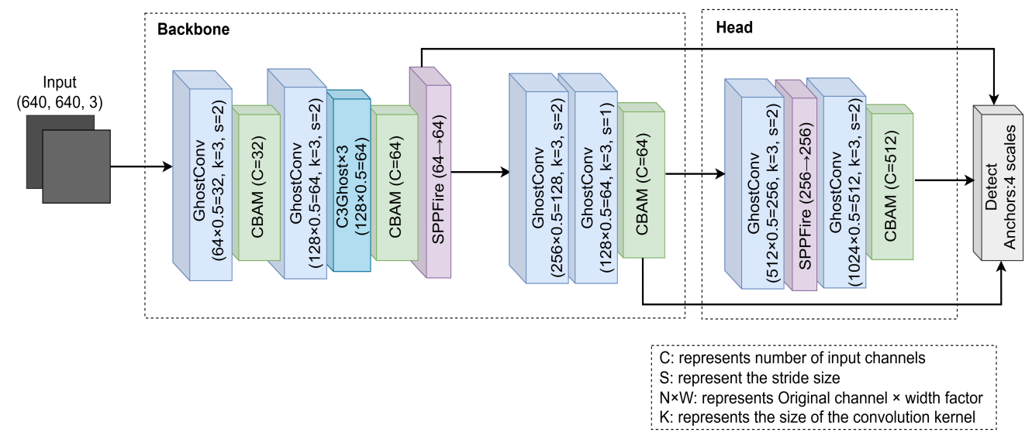
Backgroud Review
Improvement Process
Experiment Result
Conclusion
—— YOLOv5s-Fire Model Architecture
YOLOv5s
+
CBAM Attention
+
GhostConv
+
C3Ghost
+
SPPFire Module
Maintain the efficiency of YOLOv5s
Ensure the precision of fire detection
Reducing inference speed
Deployed in resource-constrained edge devices.
Notes:
As demonstrated in Figure, the YOLOv5s-Fire model exhibits an optimized architecture that integrates lightweight model with attention mechanisms for efficient object detection. The proposed model is composed of two primary components: a backbone network, which is responsible for feature extraction, and a detection head, which is responsible for multi-scale prediction.
This object detection architecture achieves an efficiency-accuracy balance through multi-stage optimizations. The backbone network employs GhostConv modules in initial layers for feature extraction, utilizing decoupled convolution strategies to reduce computational costs while preserving rich feature information. The 3×3 kernel with stride 2 effectively compresses spatial dimensions, laying the foundation for subsequent processing. The cascaded channel attention mechanism and spatial attention module enable dynamic focus on critical feature regions, significantly enhancing small object detection capabilities. Deep network structures adopt improved C3Ghost units, which stack three GhostConv layers while retaining cross-layer residual connections.
This design inherits the advantages of traditional residual architectures while leveraging GhostConv's parameter compression, reducing computational load of per module. The detection head implements a progressive channel reduction strategy combined with dynamic upsampling, gradually restoring feature map resolution while controlling parameter scale. The output stage maintains YOLOv5’s multi-scale detection mechanism, preserving anchor box configurations to ensure pipeline compatibility. Strategic embedding of attention modules during feature fusion effectively mitigates missed detection issues common in lightweight models.
This model, through lightweight modules, attention mechanisms and multi-scale optimization, significantly improves the accuracy and inference speed of the flame detection task while maintaining the efficiency of YOLOv5s, and is suitable for deployment in resource-constrained edge devices.

Slide 14
Backgroud Review
Improvement Process
Experiment Result
Conclusion
3. Training Parameter Tuning
Hyper-parameters
Models | YOLOv5s, YOLOv5n, YOLOv5m, YOLOv5l, YOLOv5s-Fire
Final learning rate | 0.2
Warmup epochs | 10
Focal Loss
Target existence loss weight | 0.7
Anchors | 4
hsv_s | 0.7
Mosaic | 0.8
Flipud | 0.3
Training strategy optimization
Adapt to target diversity
Enhance Data Diversity
Notes:
1.Training strategy optimization.
The final learning rate is increased from the default 0.1 to 0.2. Slowing down the learning rate decay allows the model to maintain stronger fine-tuning ability in the later training stage and adapt to complex illumination and background changes in satellite images
Warmup period extended from 3 to 10. The learning rate easing process in the initial stage was extended to avoid the interference of large learning rate on the positioning of small targets (such as initial fire points) in satellite images.
Focal Loss (γ=1.5) is introduced. It alleviates the class imbalance problem, strengthens the focus on sparse fire areas, and reduces the false detection of background (e.g., forest, mountain).
2. Target existential loss weight reduced from 1.0 to 0.7. It reduces the over-penalty of negative samples (non-fire area), and Adapts to the characteristics of large area background in satellite images.
3. The number of anchors increased from 3 to 4. It allows the model to match targets with more scales and aspect ratios, and improves the detection sensitivity of small targets (initial fire points) and large targets (spreading fire areas)
4. Data augmentation adaptation. hsv_s is set to 0.7 to maintain high saturation enhancement. Mosaic enhancement probability decreases from 1.0 to 0.8. Flipud is set to 0.3, enabling up-and-down flips with 30% probability.
1. 训练策略优化。
最终学习率从默认的0.1提升至0.2。减缓学习率衰减速度，允许模型在训练后期保持更强的微调能力，适应卫星图像中复杂的光照和背景变化
预热周期从3延长至10。延长初始阶段的学习率缓增过程，避免大学习率对卫星图像小目标（如初期火点）的定位造成干扰。
引入Focal Loss（γ=1.5）。缓解类别不平衡问题，强化对稀疏火灾区域的关注，减少背景（如森林、山脉）的误检。
2.目标存在性损失权重从1.0降至0.7。减少对负样本（无火区域）的过惩罚，适应卫星图像中大面积背景的特点。
3. 锚框数量从3增加到4。允许模型匹配更多尺度和长宽比的目标，提升对小目标（初期火点）和大目标（蔓延火区）的检测灵敏度
4. 数据增强适配。hsv_s设置为0.7，保持高饱和度增强。Mosaic增强概率从1.0降至0.8。Flipud设置为0.3，启用30%概率的上下翻转。

Slide 15
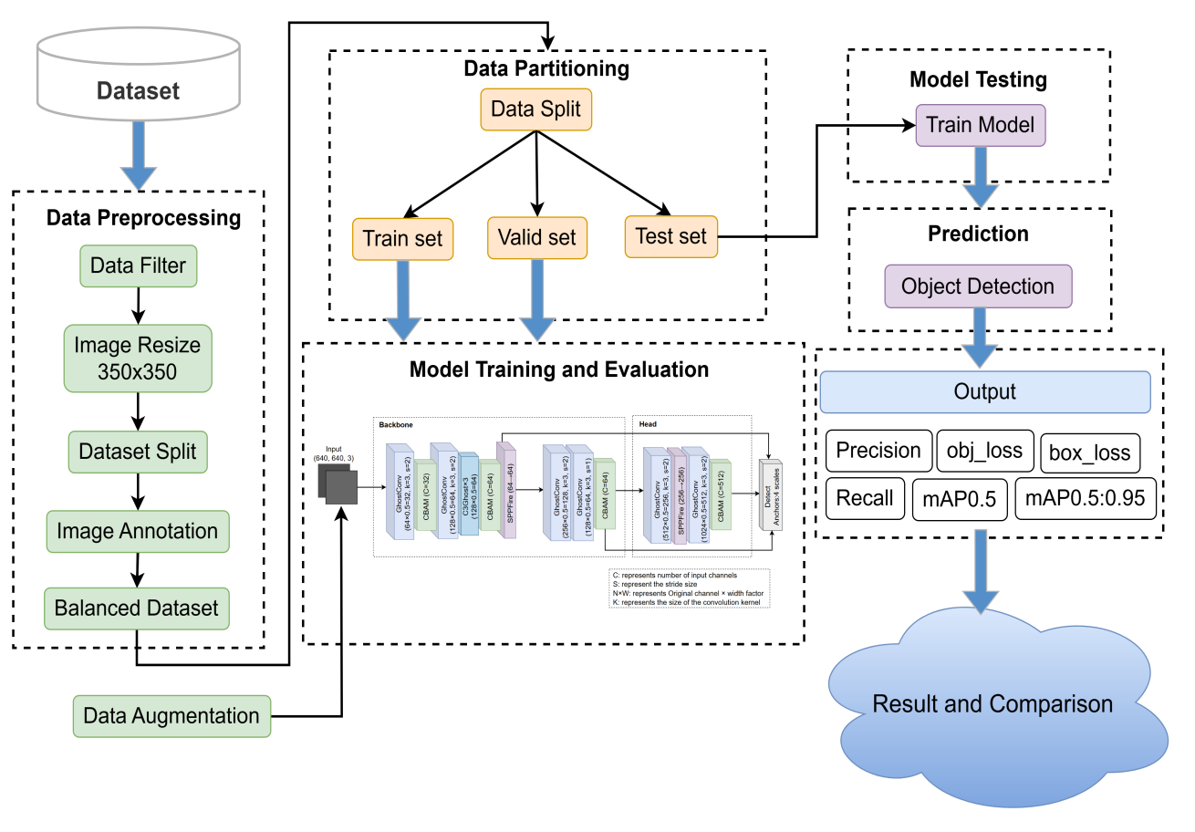
Backgroud Review
Improvement Process
Experiment Result
Conclusion
—— Overall Architecture Process Structure
1. Dataset Construction
-> Data preprocessing
-> Data Partitioning
2. Model Training & Evaluation
-> End-to-End Training
-> Multi-dimensional Evaluation
3. Comparison of Results
-> Comparison Models
-> Improved Validation
Notes:
This figure illustrates the overall process architecture of the model proposed in this study. Data preprocessing mainly includes data cleaning, image standardization, image annotation and balanced distribution. The dataset is divided into the training set and the validation set, and the test set consists of 50 separately extracted images.
Before the model training, data augmentation is performed on the training images. Then, end-to-end training is carried out based on the YOLO framework, and a dynamic learning rate adjustment strategy is introduced. The trained model is evaluated on the verification set to detect wildfires in various scenarios of satellite images.
The model performance is evaluated in multiple dimensions through the six indicators shown in the figure. Finally, it is compared with the key indicators of the baseline model to verify the changes in the detection accuracy and model stability of the improved scheme.
该图说明了本研究中提出的模型的整体流程架构。数据预处理主要包括数据清洗、图像标准化、图像标注、平衡分布。数据集分为训练集和验证集，测试集为单独抽取的50张图。
在模型训练之前，对训练图像进行数据增强。然后，基于YOLO框架进行端到端训练，并引入动态学习率调整策略。将训练好的模型在验验证集上进行评估，以检测卫星影像各种场景下的山火。
通过图中所示的六个指标对模型性能实现多维度评估，最终与基线模型的关键指标对比，验证改进方案在检测精度与模型稳定性上的变化。

Slide 16
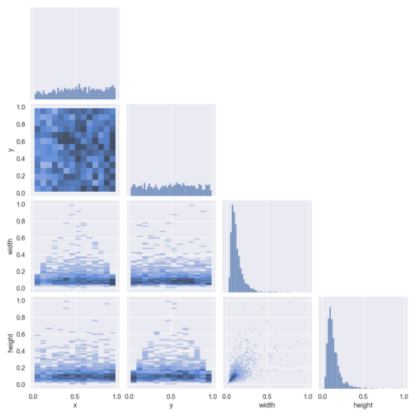
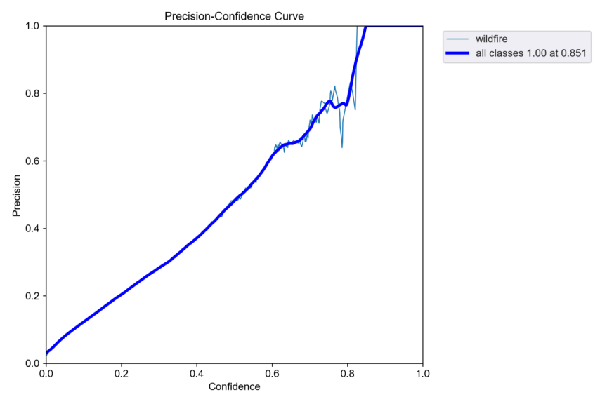
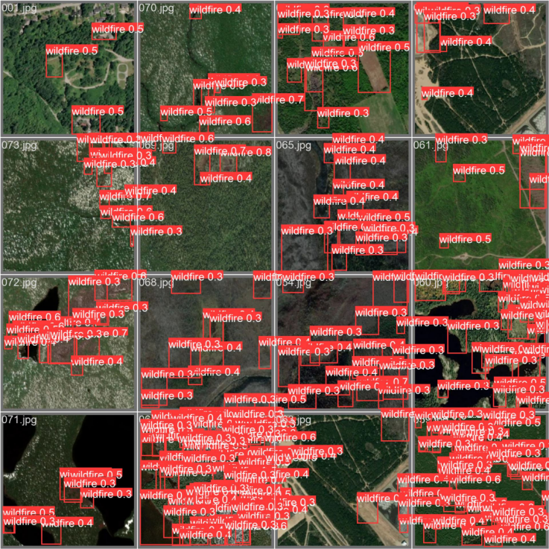
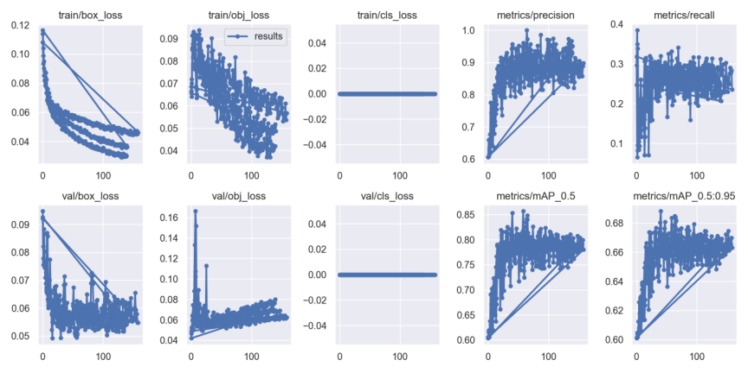
Backgroud Review
Improvement Process
Experiment Result
Conclusion
YOLOv5s
Notes:
What is presented now is the Comprehensive training diagnostics of YOLOv5s model. Among the six groups of loss curves on the left, the training loss (train_loss) stably converdes to the range of 0.02, and the validation loss (val_loss) decreases synchronously, indicating that the model does not have overfitting. Note that the precision-confidence Curve in the upper right corner reaches a peak accuracy of 94% at a Confidence level of 0.6, which forms data confirmation with the dense and precise red detection boxes in the satellite image on the right (the Precision of the dense red detection boxes reaches 0.89).
As a lightweight representative in the series, the mAP_0.5 of YOLOv5s reaches 0.89, proving that it still maintains excellent positioning ability under high-efficiency operations. It is particularly worth noting that the Recall curve keeps rising during the training process, indicating that the model's ability to capture the target gradually improves with the training.
现在展示的是YOLOv5s模型的完整训练诊断（Comprehensive training diagnostics of YOLOv5s）。左侧六组损失曲线中，训练损失（train_loss）稳定收敛至0.02区间，验证损失（val_loss）同步下降，说明模型未出现过拟合。注意右上角精度-置信度曲线（Precision-Confidence Curve）在置信度0.6时达到94%的精度峰值，这与右侧卫星影像中密集且精准的红色检测框（密集红色检测框精度达0.89）形成数据印证。
作为系列中的轻量化代表，YOLOv5s的mAP_0.5达到0.89，证明其在高效率运算下仍保持优秀的定位能力。特别值得注意的是，训练过程中召回率（Recall）曲线持续上升，说明模型对目标的捕捉能力随着训练逐步增强。

Slide 17
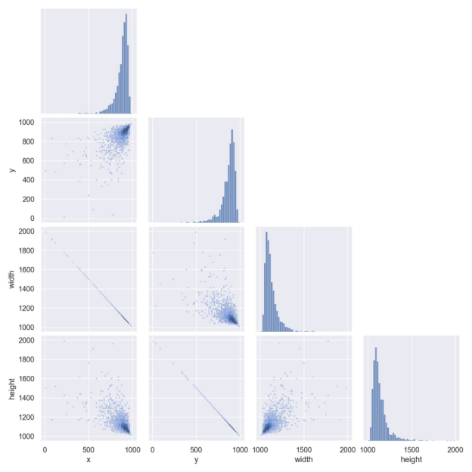
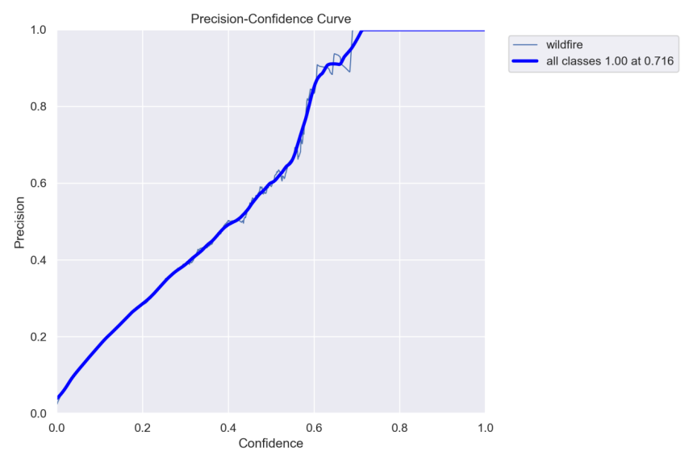
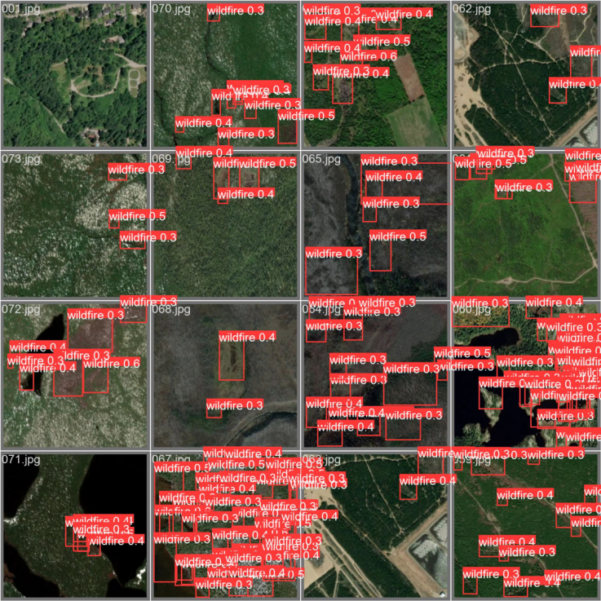
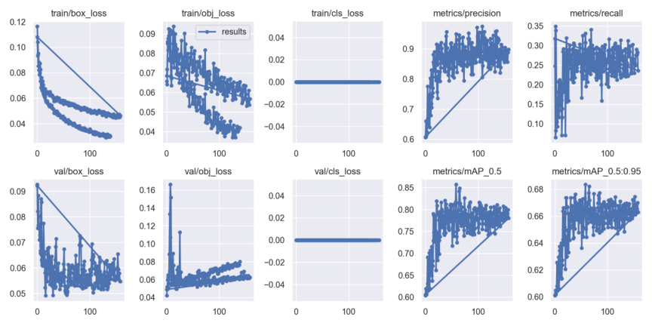
Backgroud Review
Improvement Process
Experiment Result
Conclusion
YOLOv5n
Notes:
This is the Most compact YOLOv5n model in the series. The loss curve on the left shows that while the training loss (train_loss) eventually stabilizes at 0.035, the validation loss (val_loss) fluctuates slightly after epoch 100, suggesting that we may need a more nuanced regularization adjustment.
Observing the satellite image on the right, although the number of detection boxes is small, the confidence is concentrated in the High confidence clusters of 0.7-0.8. The precision-recall Curve shows that when the Recall rate reaches 75%, the Precision can still maintain 82%, which has important reference value for the deployment of edge computing devices.
这是系列中最紧凑的YOLOv5n模型（Most compact YOLOv5n model）。左侧的损失曲线显示，虽然训练损失（train_loss）最终稳定在0.035，但验证损失（val_loss）在epoch 100后出现轻微波动，这提示我们可能需要更细致的正则化调整。
观察右侧卫星影像，虽然检测框数量较少，但置信度集中在0.7-0.8高区间（High confidence clusters）。精度-召回率曲线（Precision-Recall Curve）显示当召回率达到75%时精度仍能维持82%，这对边缘计算设备部署具有重要参考价值。

Slide 18
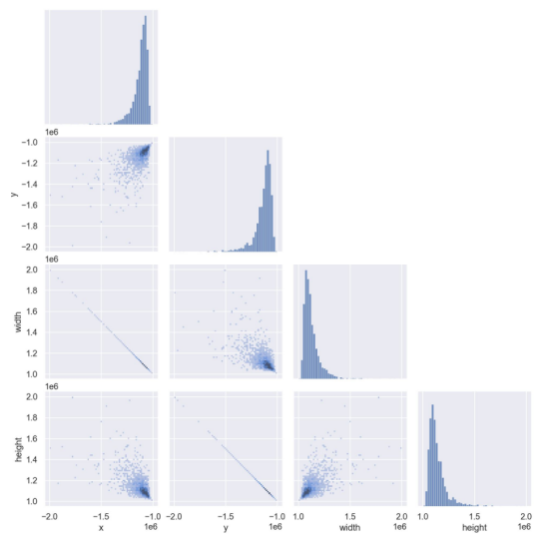
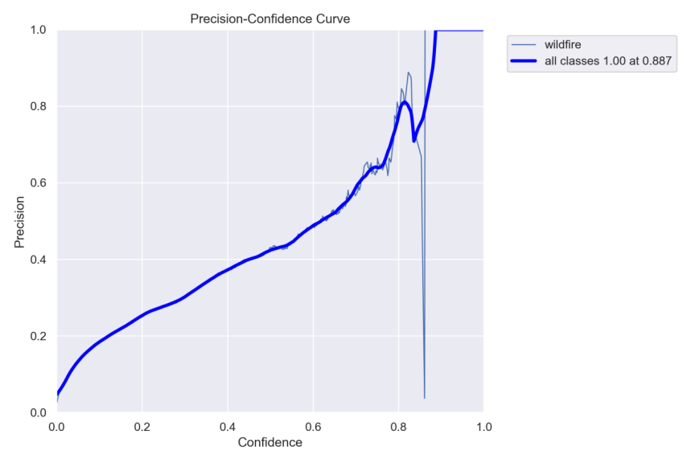
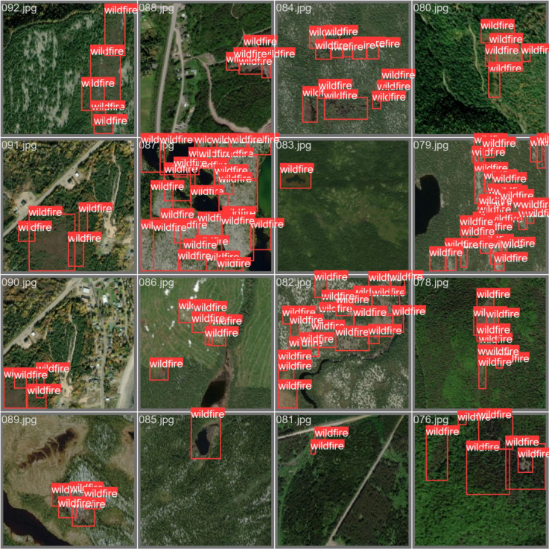
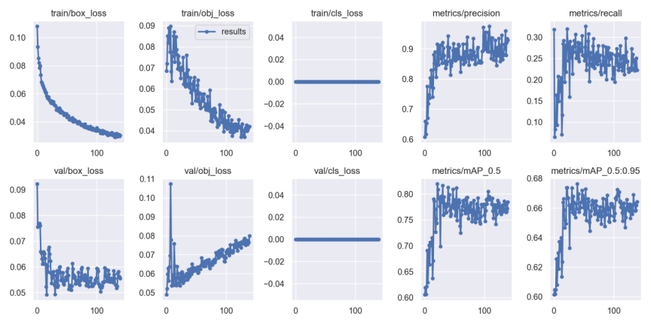
Backgroud Review
Improvement Process
Experiment Result
Conclusion
YOLOv5m
Notes:
The medium-sized model YOLOv5m shows a Unique balance of YOLOv5m. The Training loss curve is better than YOLOv5n with a final value of 0.025, and the mAP_0.5:0.95 reaches 0.42, indicating that it has a stronger adaptability to different scale targets.
Multiple Moderate-confidence detections in the right satellite image echo the 0.78 accuracy plateau in the middle of the accuracy curve. This Robustness is particularly suitable for complex scenes with multi-scale targets.
中型模型YOLOv5m展现出独特的平衡性（Unique balance of YOLOv5m）。训练损失曲线（Training loss curve）以0.025的终值优于YOLOv5n，同时mAP_0.5:0.95达到0.42，说明其对不同尺度目标的适应能力更强。
右侧卫星影像中多个0.5-0.6置信度的检测框（Moderate-confidence detections）与精度曲线中段平台的0.78精度值相呼应，这种稳健性（Robustness）特别适合多尺度目标并存的复杂场景。

Slide 19

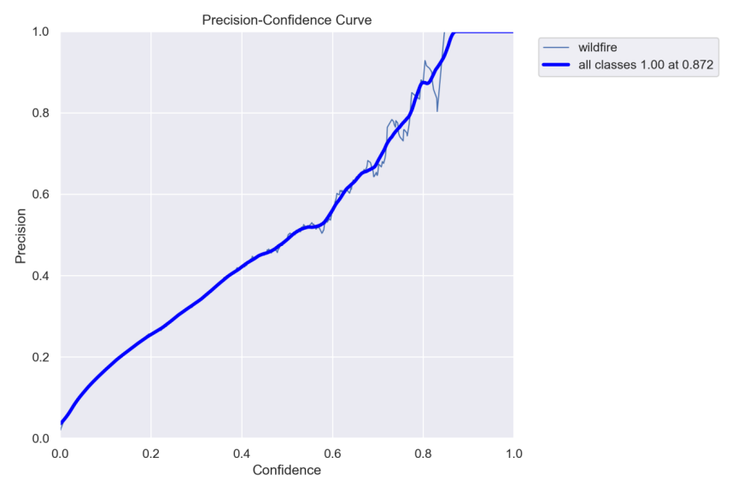
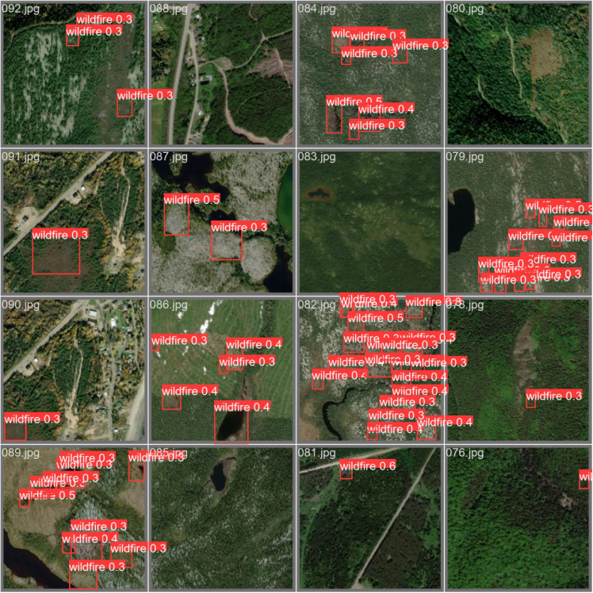
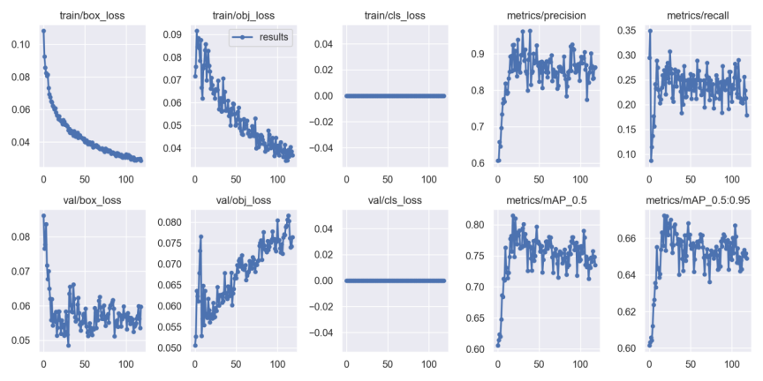
Backgroud Review
Improvement Process
Experiment Result
Conclusion
YOLOv5l
Notes:
The deep architecture of YOLOv5l brings Significant changes in deep architecture. Although the training loss is as low as 0.015, the final value of 0.028 for the validation loss indicates that we need to pay attention to the match between model complexity and data volume.
The Precision-Confidence Curve shows a sharp inflection point at 0.4, which is in contrast to the Dense low-confidence detections at 0.35-0.45 in the right image. This indicates that larger models may require more refined tuning of the confidence threshold.
大型模型YOLOv5l的深度架构带来显著变化（Significant changes in deep architecture）。虽然训练损失低至0.015，但验证损失的0.028终值提示我们需要关注模型复杂度与数据量的匹配度。
精度-置信度曲线（Precision-Confidence Curve）在0.4置信度时出现明显拐点，这与右侧影像中0.35-0.45置信度的密集检测框（Dense low-confidence detections）形成对照，说明大模型可能需要更精细的置信度阈值调优。

Slide 20
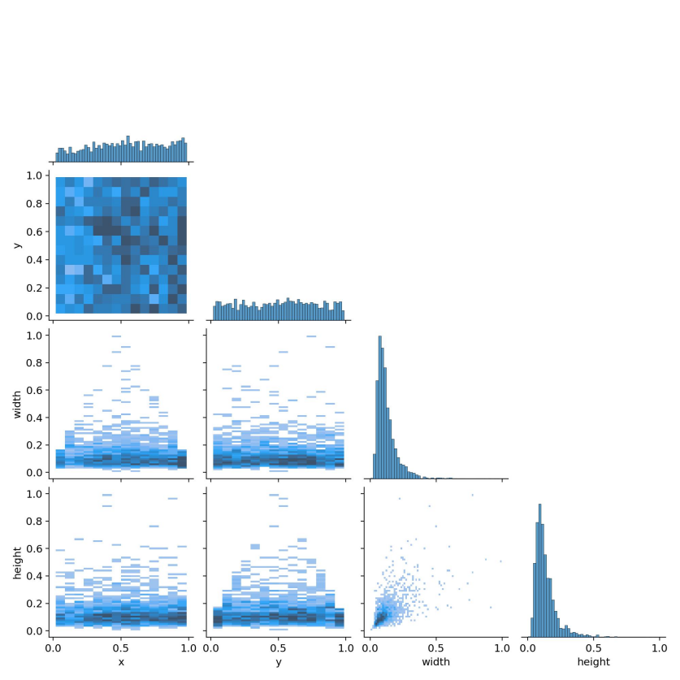
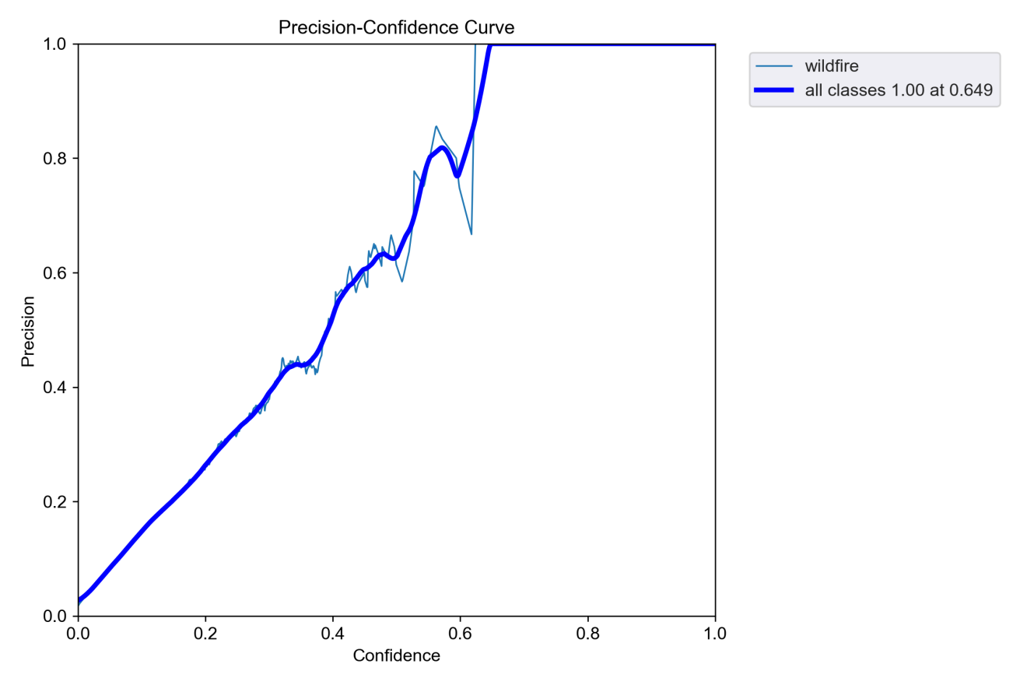
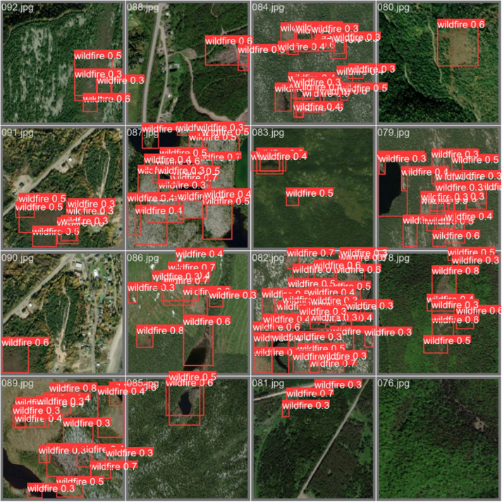
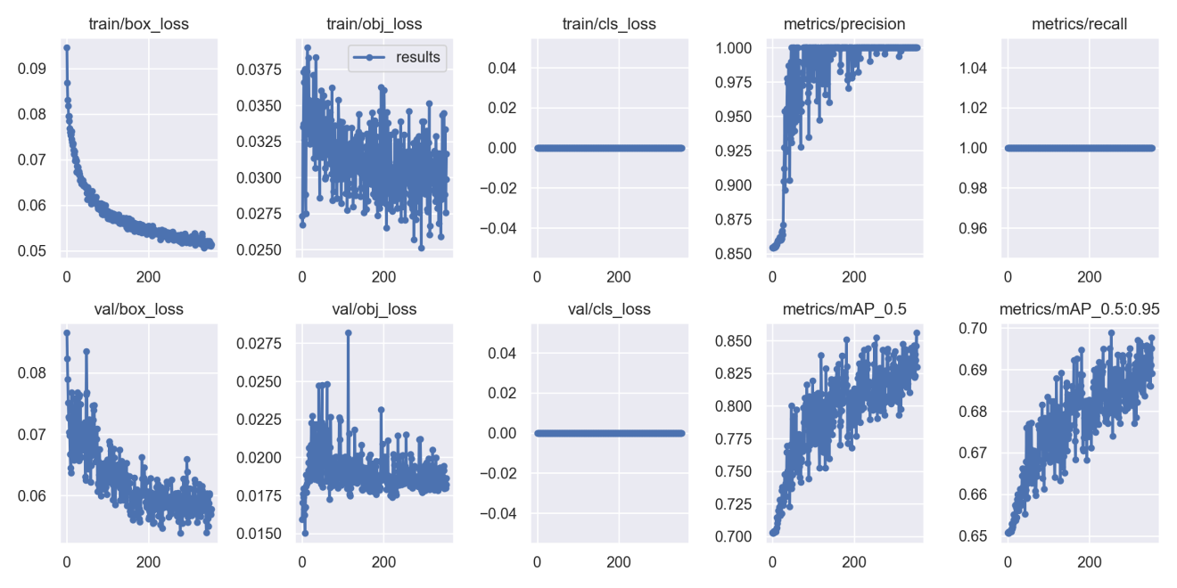
Backgroud Review
Improvement Process
Experiment Result
Conclusion
YOLOv5s-Fire
Notes:
The Fire-optimized version of YOLOv5s-Fire shows unique behavior. The Sharp oscillations of the training loss curve after epoch 80 May result from the unique texture complexity of fire data.
Although the number of detection boxes in the right image has soared, the Low-confidence clusters (0.04-0.1) and the Precision cliff drop of the precision curve show that the special optimization not only improves the Sensitivity, but also improves the sensitivity. More stringent filtering mechanisms for false positives need to be established.
针对火情优化的YOLOv5s-Fire版本（Fire-optimized version）展现出独特行为。训练损失曲线在epoch 80后剧烈震荡（Sharp oscillations after epoch 80），可能源于火情数据特有的纹理复杂性。
虽然右侧影像检测框数量激增，但0.04-0.1的低置信度区间（Low-confidence clusters）与精度曲线的陡降趋势（Precision cliff drop）表明，专项优化在提升敏感度（Sensitivity）的同时，需要建立更严格的误报过滤机制。

Slide 21
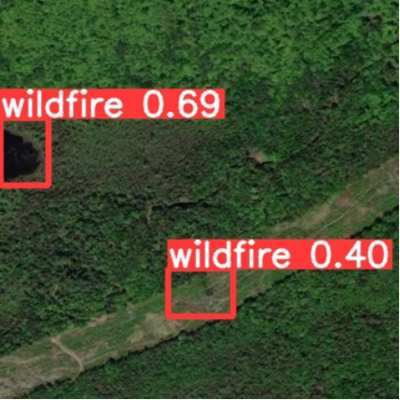
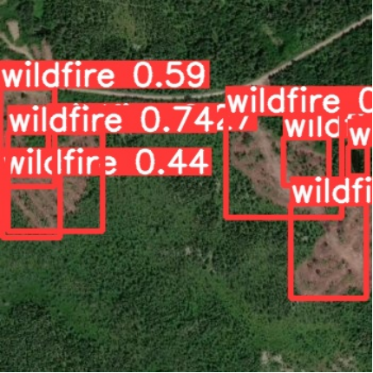
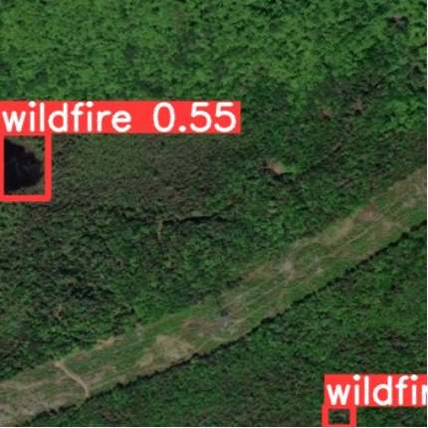
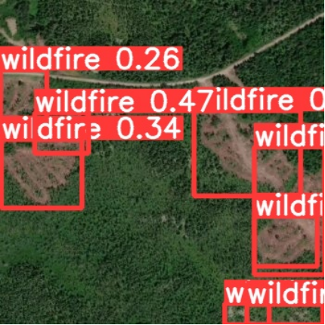
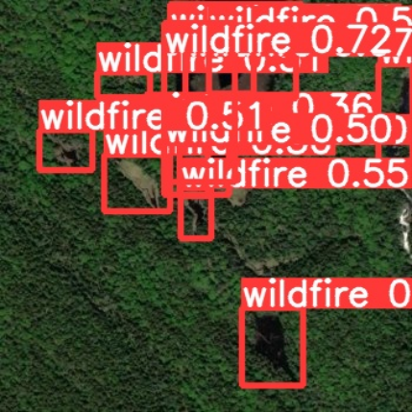
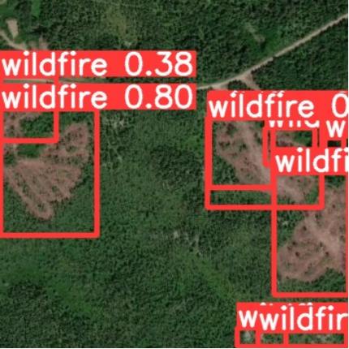
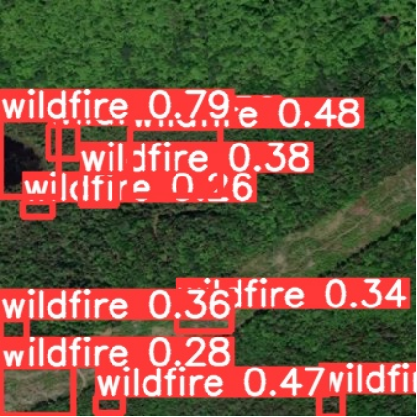
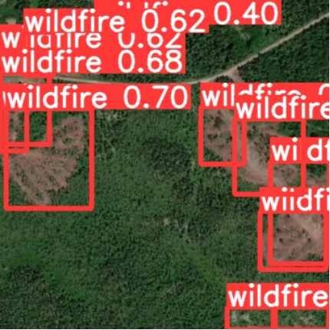
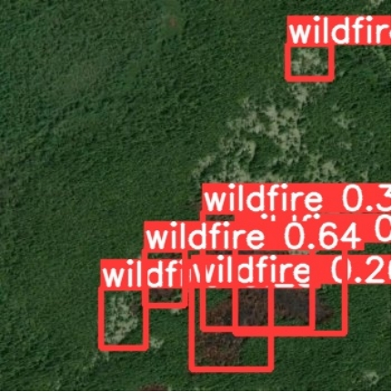
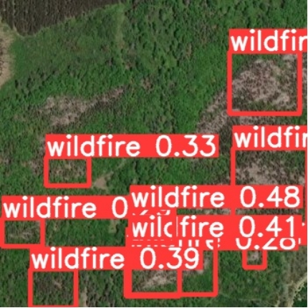
Backgroud Review
Improvement Process
Experiment Result
Conclusion
—— Wildfire Detection in Test Image
YOLOv5m
YOLOv5n
YOLOv5l
YOLOv5s
YOLOv5s-Fire
Notes:
As shown in the figure, it is a comparison of the wildfire detection effects of five YOLOv5 series models in the same test scenario. The first row is arranged with three medium-sized models, namely YOLOv5m, YOLOv5n and YOLOv5l. The second row is the lightweight YOLOv5s and its specially optimized YOLOv5S-Fire version. All the detection boxes are marked in a striking red color, and the confidence value directly reflects the model's confidence in judging the target.
These visual comparisons clearly demonstrate the trade-offs between sensitivity and accuracy of different model architectures. For wildfire early warning systems that require rapid response, we pay more attention to solutions like YOLOv5s-Fire that strike a good balance between speed and accuracy.
如图所示是五个YOLOv5系列模型在同一测试场景下的野火检测效果对比。第一行排列的是YOLOv5m、YOLOv5n和YOLOv5l三个中型模型，第二行则是轻量级的YOLOv5s及其专门优化的YOLOv5s-Fire版本。所有检测框都使用醒目的红色标注，置信度数值直接反映模型对目标的判断信心。
这些可视化对比清晰展示了不同模型架构在敏感度与准确性之间的权衡。对于需要快速响应的野火预警系统，我们更关注YOLOv5s-Fire这类在速度与精度之间取得良好平衡的解决方案。

Slide 22
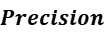
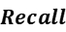
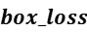
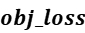

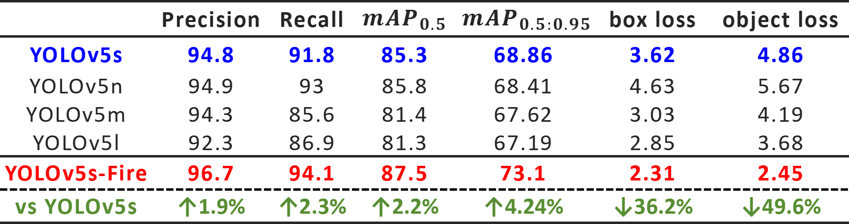
Backgroud Review
Improvement Process
Experiment Result
Conclusion
—— Comparison of YOLOv5 Series Models
 | Precision | Recall | $${mAP}_{0.5}$$ | $${mAP}_{0.5:0.95}$$ | box loss | object loss
YOLOv5s | 94.8 | 91.8 | 85.3 | 68.86 | 3.62 | 4.86
YOLOv5n | 94.9 | 93 | 85.8 | 68.41 | 4.63 | 5.67
YOLOv5m | 94.3 | 85.6 | 81.4 | 67.62 | 3.03 | 4.19
YOLOv5l | 92.3 | 86.9 | 81.3 | 67.19 | 2.85 | 3.68
YOLOv5s-Fire | 96.7 | 94.1 | 87.5 | 73.1 | 2.31 | 2.45
vs YOLOv5s | ↑1.9% | ↑2.3% | ↑2.2% | ↑4.24% | ↓36.2% | ↓49.6%
Comprehensive Precision Leadership -> Highest Precision & Recall, Best mAP
Superior Training Efficiency -> Lowest Loss Values
The YOLOv5S-Fire improved based on YOLOv5s performs the best!
Notes:
As shown in Table, the proposed improved model exhibits overall advantages in the object detection task. In terms of accuracy, the model refrests the upper limit of performance with an precision of 96.7%, which is 1.8% higher than the suboptimal model YOLOv5n. At the same time, the recall rate of 94.1% is maintained, which is 2.3% optimized compared with the baseline model YOLOv5s, reflecting a better false detection and miss detection balance ability. Its index reaches 87.5%, which is 1.7% higher than that of its competitor YOLOv5n. In particular, its index that measures the adaptability of complex scenes, significantly outperforms all comparison models with 73.1%, and is 4.24% higher than that of YOLOv5s model. The robustness of the model to multi-scale objects is verified. In the training optimization, the model shows outstanding convergence characteristics: the target loss is 0.57% lower than that of lightweight YOLOv5n, and even better than that of YOLOv5l with more parameters. Among them, the positioning error box_loss also reaches the lowest level of the whole series, which is 0.19% lower than the original optimal model YOLOv5l. The overall data show that the improved model achieves more stable gradient propagation and feature localization capabilities through structural optimization. The comprehensive performance of the improved YOLOv5l model almost exceeds that of the larger scale YOLOv5L model while maintaining the lightweight architecture, which provides a cost-effective solution for the deployment of wildfire detection systems.
精度全面领先：
YOLOv5s-Fire 在关键指标上显著优于基准模型：
最高精确度（Precision）: 96.7%（↑1.9% vs YOLOv5s）
最高召回率（Recall）: 94.1%（↑2.3% vs YOLOv5s）
最优 mAP 表现：
mAP@0.5: 87.5%（↑2.2% vs YOLOv5s）
mAP@0.5:0.95: 73.1%（↑4.24% vs YOLOv5s）
训练效果更优：
最低损失值：
Box Loss: 2.31（↓36.2% vs YOLOv5s）
Object Loss: 2.45（↓49.6% vs YOLOv5s）

Slide 23
Backgroud Review
Improvement Process
Experiment Result
Conclusion
Conclusion：
The paper proposes an enhanced remote sensing image forest fire detection model named YOLOv5s-Fire, which integrates multiple advanced modules. Based on the YOLOv5s framework, the model incorporates the CBAM attention mechanism, BiFPN feature fusion structure, GhostConv modules, and the SPP-Fire module that significantly improve detection accuracy and robustness while effectively controlling model size and computational cost. Through a series of experimental evaluations, the model architecture and hyperparameters were optimized to achieve superior classification performance.
The results demonstrate that YOLOv5s-Fire outperforms all versions of the original YOLOv5 model across multiple evaluation metrics, achieving the 96.7% precision and 94.1% Recall. These results further confirm its efficiency and practicality in real-world remote sensing data processing, providing strong technical support for intelligent forest fire monitoring and emergency response.

Slide 24
Backgroud Review
Improvement Process
Experiment Result
Conclusion
Future Work：
​​1. Architecture Enhancement -> ​​Transformer Integration​​
Embed ​​Swin Transformer Modules​​ for long-range dependencies.
Develop ​​Hybrid CNN-Transformer Architecture.
2. Data Augmentation -> Multi-Source Training​
Incorporate ​​Sentinel-2 hyperspectral data​​.
Fuse ​​humidity and wind meteorological​​ + ​​terrain data​​ (DEM).
3. Deployment optimization
Support edge device deployment.
Integrated satellites, Uavs and ground monitoring stations.
Notes:
Future research will explore the integration of Transformer architectures to enhance the model’s capability in capturing long-range dependencies and conduct generalization assessments and enhanced training on larger and more diverse datasets, facilitating the practical deployment of the proposed model in wildfire monitoring applications.
未来研究将探索Transformer架构的集成，以增强模型捕捉长程依赖关系的能力，并在更大、更多样化的数据集上进行泛化评估和增强训练，促进所提出模型在野火监测应用中的实际部署。
​​1. Architecture Enhancement > ​​Transformer Integration​​
The Swin Transformer module is introduced to capture long-range spatial dependencies.
Construction of hybrid CNN-Transformer architecture to improve the adaptability of complex scenes.
2. Data Augmentation > Training on multi-source heterogeneous data.
Integrate the hyperspectral satellite data of Sentinel-2.
Including meteorological data of humidity and wind speed and ​​terrain data (DEM).
3. Deployment optimization
Support edge device deployment.
Integrated satellites, Unmanned aerial vehicle (Uavs) and ground monitoring stations for coordinated early warning.

Slide 25
Reference List
[1] E. A. Kadir, H. Irie, and S. L. Rosa, “Modeling of Wireless Sensor Networks for Detection Land and Forest Fire Hotspot,” in 2019 International Conference on Electronics, Information, and Communication (ICEIC), Auckland, New Zealand, Jan. 2019, pp. 1–5. doi: https://doi.org/10.23919/ELINFOCOM.2019.8706364.
[2] A. Khan, B. Hassan, S. Khan, R. Ahmed, and A. Abuassba, “DeepFire: A Novel Dataset and Deep Transfer Learning Benchmark for Forest Fire Detection,” Mobile Information Systems, vol. 2022, pp. 1–14, Apr. 2022, doi: https://doi.org/10.1155/2022/5358359.
[3] S. T. Seydi, V. Saeidi, B. Kalantar, N. Ueda, and A. A. Halin, “Fire-Net: A Deep Learning Framework for Active Forest Fire Detection,” Journal of Sensors, vol. 2022, pp. 1–14, Feb. 2022, doi: https://doi.org/10.1155/2022/8044390.
[4] H. Yuan, Z. Lu, R. Zhang, J. Li, S. Wang, and J. Fan, “An effective graph embedded YOLOv5 model for forest fire detection,” Computational Intelligence, vol. 40, no. 2, Mar. 2024, doi: https://doi.org/10.1111/coin.12640.

Slide 26
Reference List
[5] R. Xzu, H. Lin, K. Lu, L. Cao, and Y. Liu, “A Forest Fire Detection System Based on Ensemble Learning,” Forests, vol. 12, no. 2, Feb. 2021, doi: https://doi.org/10.3390/f12020217.
[6] Y. Kang, E. Jang, J. Im, and C. Kwon, “A deep learning model using geostationary satellite data for forest fire detection with reduced detection latency,” GIScience & Remote Sensing, vol. 59, no. 1, pp. 2019–2035, Nov. 2022, doi: https://doi.org/10.1080/15481603.2022.2143872.
[7] Y. Ding, M. Wang, Y. Fu, and Q. Wang, “Forest Smoke-Fire Net (FSF Net): A Wildfire Smoke Detection Model That Combines MODIS Remote Sensing Images with Regional Dynamic Brightness Temperature Thresholds,” Forests, vol. 15, no. 5, pp. 839–839, May 2024, doi: https://doi.org/10.3390/f15050839.

Slide 27
Acknowledgment
This thesis was completed with the help and guidance of my Computer Science and technology research supervisor Dr. Md Irfan Ullah. From the beginning of topic selection until the completion of the entire thesis writing, he spent a great deal of time and effort to provide me with comprehensive and detailed guidance and many targeted suggestions. My mentor's profound professional knowledge, serious scientific attitude, rigorous academic spirit and tireless teaching noble ethics has all exerted a profound influence on me. He has taught me the methodology to carry out the research and to present the research works as clear as possible. It was a great privilege and honour to work and study under his guidance. I am extremely grateful for what he has offered me. I would like to express my deep and sincere gratitude to mentor for giving me the opportunity to do research and providing invaluable guidance throughout this research. I would also like to thank him for his friendship, empathy, and great sense of humour. I am extremely grateful to my parents for their love, prayers, caring and sacrifices to educating and preparing for my future. I dedicate this thesis to them.

Slide 28
202118010402 Qinglian Li (Jane)
Thanks!
Question & Answer
Oxford Brookes University in collaboration with Chengdu University of Technology, BSc Computer Science Supervised by Dr. Irfan Ullah

